Slide 1


Mini Project (CSE7102)
REVIEW-1
29-08-2026
Presidency
School of Computer Science and Engineering

Slide 2
PROJECT TITLE
CSS7102- Mini Project Review-1
Project ID: 289
Panel No: 18
Group members details:
Under the Supervision of,
Dr./Mr./Ms./Prof.
Professor / Associate Professor / Assistant Professor
School of Computer Science and Engineering
Presidency University
Sl.No | Student Name | Roll Number
1 | Manaswi Bhujange | 20231CSE0430
2 | Shinde Nandini | 20231CSE0421
3 | Biradar Ashwini | 20231CSE0400
Name of the Program(s): B Tech
Name of the HoD (Team Leader’s): Dr. Asif Mohammad
Name of the Program Project Coordinator (Team Leader’s): Dr.Jayavadivel Ravi
Name of the School Project Coordinators: Mr. Muthuraju V

Slide 3
INDEX
Problem Statement
Git Hub Link
Introduction
Literature Review
Architecture Diagram
Analysis of Problem Statement/Output Expected
Timeline of the Project(Gantt Chart)
References

Slide 4
Problem Statement Number: 289
Category (Hardware / Software / Both) : Software
Problem Description:
Shipment information is spread acrossmultiple transport stages.
Delays and disruptions can be identifiedtoo late.
Manual monitoring makes coordination difficult.
Decision-makers need one clear view of shipment status.
Difficulty Level: High

Slide 5
Github Link
Github Link to the Project Repository

Slide 6
Introduction
About the project:
Centralize shipment and transportation-event data.
Provide a single dashboard for road + rail visibility.
Use AI for delay and ETA prediction.
Use cloud infrastructure for storage and access.
Benefits:
1.Better visibility across the shipment journey.
2. Less manual tracking and fewer information gaps.
3. Faster response to predicted delays.
4. Data-driven operational decisions.

Slide 7
Literature Review
Refer the full literature survey here
The Problem: What the Research found
Coal gives India ~70% of its electricity (Ilahi, 2024)
Coal moves by truck, train, and sometimes barge or ship (Ilahi, 2024)
Coal transport is fragmented, each stage tracked in a separate system (Pandey et al., 2025)
Wagon turnaround takes ~5 days (Ministry of Coal, 2022)
Rake shortages: 241 loaded/day vs 273 target (Ministry of Coal, 2022)
~60 million tonnes of coal stranded at mines in 2022 (Ilahi, 2024)
1,900 trains cancelled that year to prioritize coal (Ilahi, 2024)
Railways carry only ~half of Coal India's dispatches, rest by truck (Ilahi, 2024)
Inland waterways carry less than 0.5% of India's freight (Gupta, 2017)
All sources agree: lack of visibility is a core problem (Pandey et al., 2025)

Slide 8
Literature Review
Refer the full literature survey here
What the Literature Has Already Researched
Defined supply chain visibility: sharing timely, accurate, useful info (Barratt & Oke, 2007; Kalaiarasan et al., 2022)
Built the ABCDE framework of visibility: antecedents, barriers, drivers, effects (Kalaiarasan et al., 2022)
Proposed a unified multimodal coal visibility platform (Pandey et al., 2025)
Solved arrival-time prediction with one ML model per transport leg (Balster et al., 2020)
Improved ETA accuracy 15-20% with hybrid methods (Wani, 2025)
Detected disruptions by combining tracking data with text via NLP (Ouedraogo et al., 2025)
Applied blockchain to the coal supply chain with smart contracts (Alam et al., 2025)
Found data-sharing and governance decide platform success, not technology (Wycislak, 2021)
Built a digital twin of a supply chain, reaching 94% service level (Maheshwari et al., 2023)
Confirmed Indian Railways already tracks freight in real time via FOIS (Jain, 2022)

Slide 9
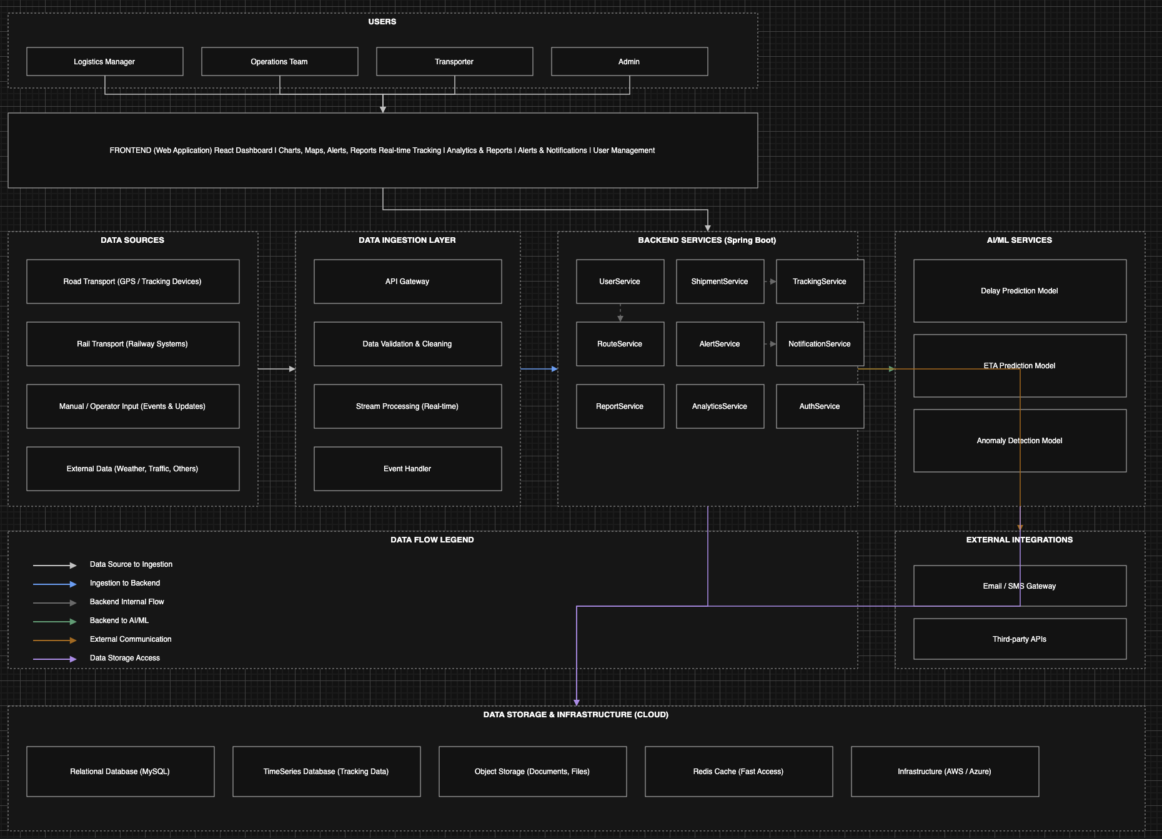
Architecture Diagram - View

Slide 10
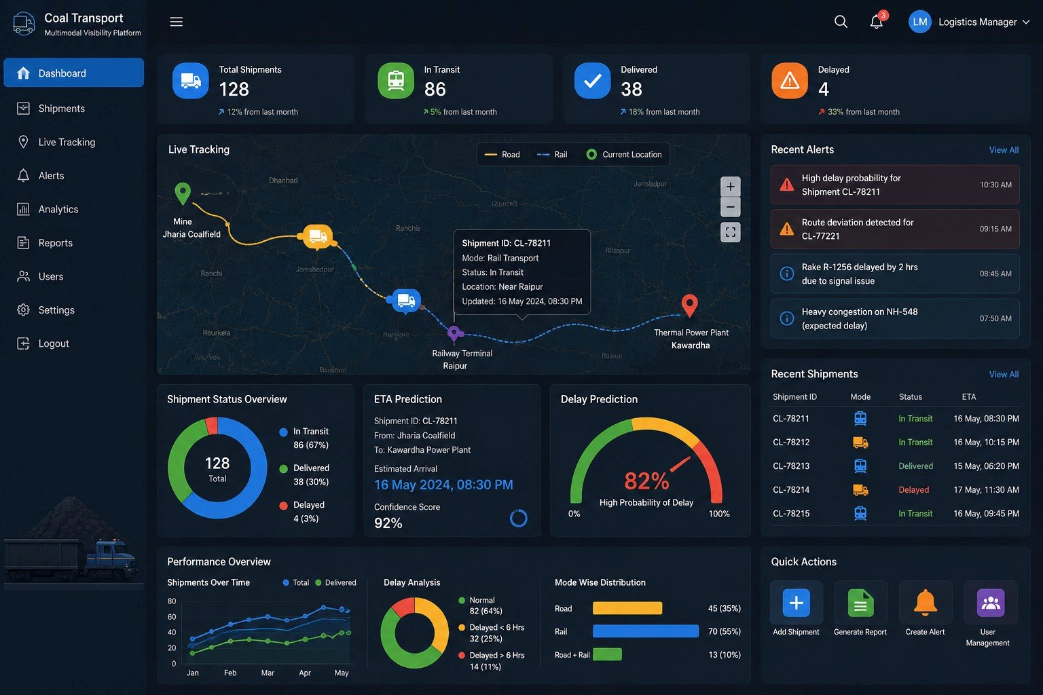
Analysis of Problem Statement /Output Expected

Slide 11
Analysis of Problem Statement (contd...)
Hardware Requirements
GPS trackers on trucks and barges
RFID tags and readers at gates and weighbridges
IoT gateway devices to send sensor data to the cloud
Cloud servers (AWS / Azure) for backend, database, and AI models
Development laptops for building and testing
Software Requirements
Frontend: React.js for the dashboard, maps and charts for live tracking
Backend: Java Spring Boot for APIs, Spring Security for login and roles
Real time: Kafka for stream processing and event handling
Database: MySQL (records), TimescaleDB or InfluxDB (tracking data), Redis (cache)
AI/ML: Python with scikit-learn, XGBoost, TensorFlow for delay, ETA, and anomaly models
Integrations: FOIS and ULIP APIs for rail data, weather and traffic APIs, Email/SMS gateway for alerts
Deployment: Linux, Docker, Kubernetes, GitHub Actions for CI/CD

Slide 12
Analysis of Problem Statement (contd...)
Core problem: coal shipments move through multiple transport modes, but eachmode is tracked in a separate system, or not tracked at all
Who is affected: mines, transporters, railways, and power plants all work withincomplete and delayed information
Why it matters: coal powers ~70% of India's electricity, so transport delays directlythreaten power supply (Ilahi, 2024)
Root causes: fragmented data, manual record keeping, no single data standard, andlow willingness to share information between organizations (Wycislak, 2021)
Impact: delayed shipments, stranded coal at mines, poor arrival predictions, andhigher logistics cost (Ministry of Coal, 2022)
What solving it needs: one real-time platform that integrates data across truck, rail,and waterway modes, and gives every stakeholder the same live view

Slide 13
Timeline of the Project (Gantt Chart)
Research Survey & Planning Requirements (Aug 16 – Aug 28): literature survey of 16 papers (supply chain visibility, ETA prediction, blockchain, coal logistics), requirements and module analysis, technology stack selection (React, Spring Boot, Kafka, MySQL, TimescaleDB, Python ML)
System Design (Sep 1 – Sep 21): layered architecture (sensing → ingestion → backend → AI/ML → presentation), database schema and REST API design, microservice breakdown, dashboard wireframes
Development (Sep 22 – Nov 9): Spring Boot REST APIs with JWT role security, React dashboard with live maps and charts, Kafka + WebSocket real-time tracking pipeline, ETA/delay prediction models (XGBoost/LSTM), GPS and RFID data integration
Integration & Testing (Nov 3 – Nov 23): module integration, API and end-to-end workflow testing, streaming pipeline performance testing, bug fixing and QA
Deployment & Submission (Nov 17 – Nov 30): Docker + Kubernetes deployment, CI/CD with GitHub Actions, cloud hosting (AWS/Azure), documentation, final demo and viva

Slide 14
References (IEEE Paper format)
Add APA Citation for all references.
Use the below link for various APA styles :
https://www.indeed.com/career-advice/career-development/how-to-cite-a-research-paper
Kalaiarasan et al. (2022). The ABCDE of supply chain visibility. Int. J. Production Economics.
Barratt & Oke (2007). Antecedents of supply chain visibility. J. Operations Management.
Pandey et al. (2025). Multi-modal visibility of coal transportation. ICAAAI 2025, Atlantis Press.
Balster et al. (2020). ETA prediction for intermodal transport networks. Business & Inf. Systems Engineering.
Wani (2025). Ten tips for improving ETA predictions using ML. PeerJ Computer Science.
Ouedraogo et al. (2025). Real-time multimodal container transport risk management. Eng. Applications of AI.
Alam et al. (2025). Blockchain-based coal supply chain management. Discover Computing.
Wycislak (2021). Real time visibility in a transportation network. Int. J. Supply Chain Management.
Maheshwari et al. (2023). Digital twin-driven real-time supply chain control. Technological Forecasting & Social Change.
Gupta (2017). Inland waterways transportation in India. Journal of Commerce and Trade.
Raghuram (2006). Viability of inland water transport in India. IIM Ahmedabad.
Sudhakaran et al. (2024). Smart data for IoT-based railway system using RFID. Automatika.
Jimoh et al. (2025). IoT based vehicle tracking system. J. Engineering Research & Development.
Ilahi (2024). Coal supply chain in India: Challenges & road ahead. TIJER.
Ministry of Coal (2022). Draft National Coal Logistics Plan. Government of India.
Jain (2022). Indian Railways' freight IT system. Global Railway Review.

Slide 15


